Slide 1


FACULTY OF COMPUTER AND INFORMATION SCIENCE, ASU
CS DEPARTMENT
Automatic Attendance System

Slide 2
Team Members
Youssef Ashraf Sobhy
Nouran Taha Abdelmenem
Youssef Hany Anter
Mohammed Ahmed Fathy
Supervisors
Prof . Zaki Taha
TA . Ghada Elshamy

Slide 3
Table Of Contents
1- Introduction
2- Problem Definition & Motivation
3- Objective
4- System Architecture
5- Phases description
6- Experimental Results
7- Demo
8- Conclusion & Future work
9- References

Slide 4
Introduction
In many institutions and organization the attendance is a very
important factor for various purposes and its one of the important
criteria that is to follow for students and organization employees.
The previous approach in which manually taking and maintains
the attendance records was very inconvenient task.
After having these issues in mind we develop an automatic
attendance system which automates the whole process of
taking attendance and maintaining it.

Slide 5
Problem Definition
When you have a large number of employees it is not easy to take the attendance for everyone as
It takes too much time
It takes too much effort
losing the paper of attendance
It is dangerous considering the spread of viruses and epidemics

Slide 6
Motivation

Slide 7
Recording attendance by signing or using fingerprint for each employee or student takes much time
With the recent spread of corona virus , it will be dangerous to communicate between employees or students
In general manual recording has many other issues that make a false presence, losing attendance

Slide 8
Objectives
Easier
Faster
Accurate
Safety

Slide 9
System Architecture

Slide 10
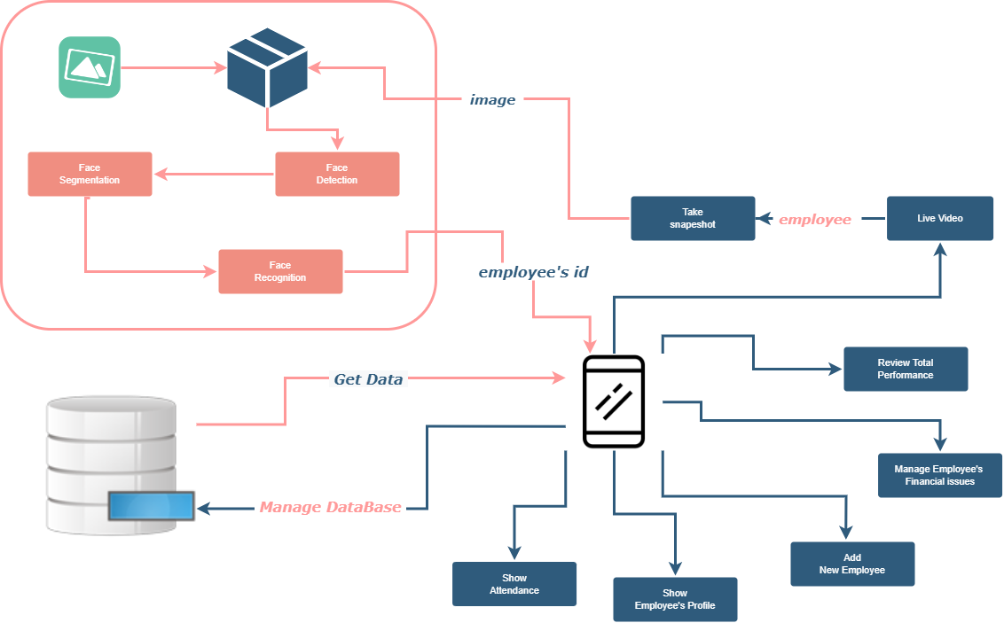

Slide 11
Phases description

Slide 12
Training Model Steps:
1: face detection
2: Posing and Projecting Faces
3: Encoding Faces

Slide 13
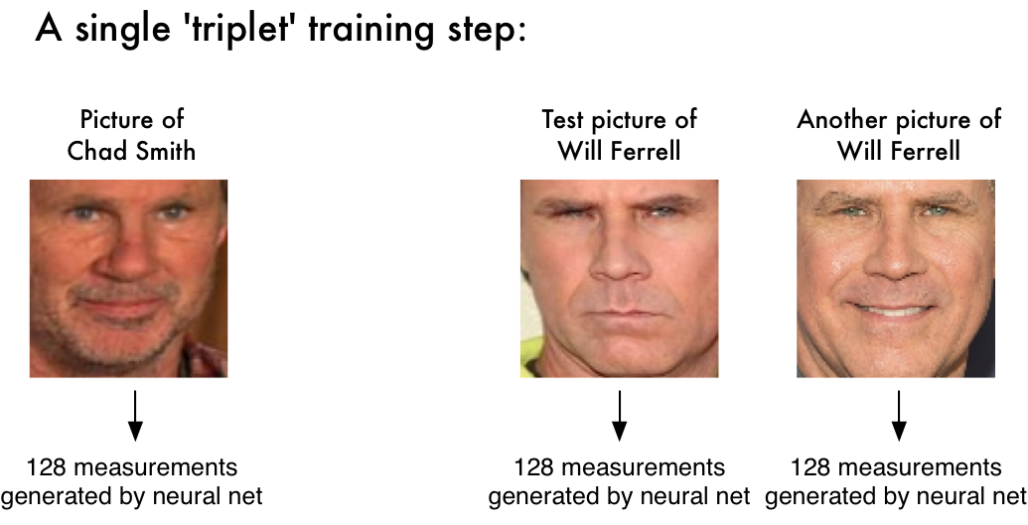

Slide 14
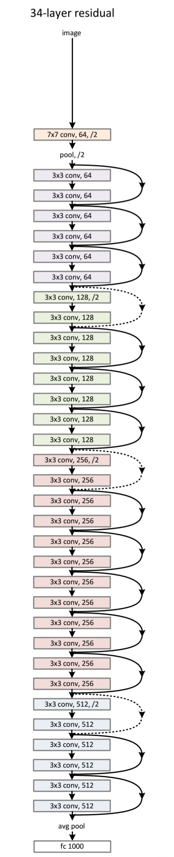
ResNet Architecture:

Slide 15
Experiment different Models
OpenFace | VGG-Face | DeepID | Dlib
OpenFace achieves 93.80% accuracy on the LFW dataset. | achieves a 97.78% accuracy on the popular Labeled Faces in the Wild (LFW) dataset. | DeepID2 achieved 99.15% on the Labeled Faces in the Wild (LFW) dataset. | dlib model achieved an accuracy of 99.38% on the standard LFW face recognition benchmark

Slide 16
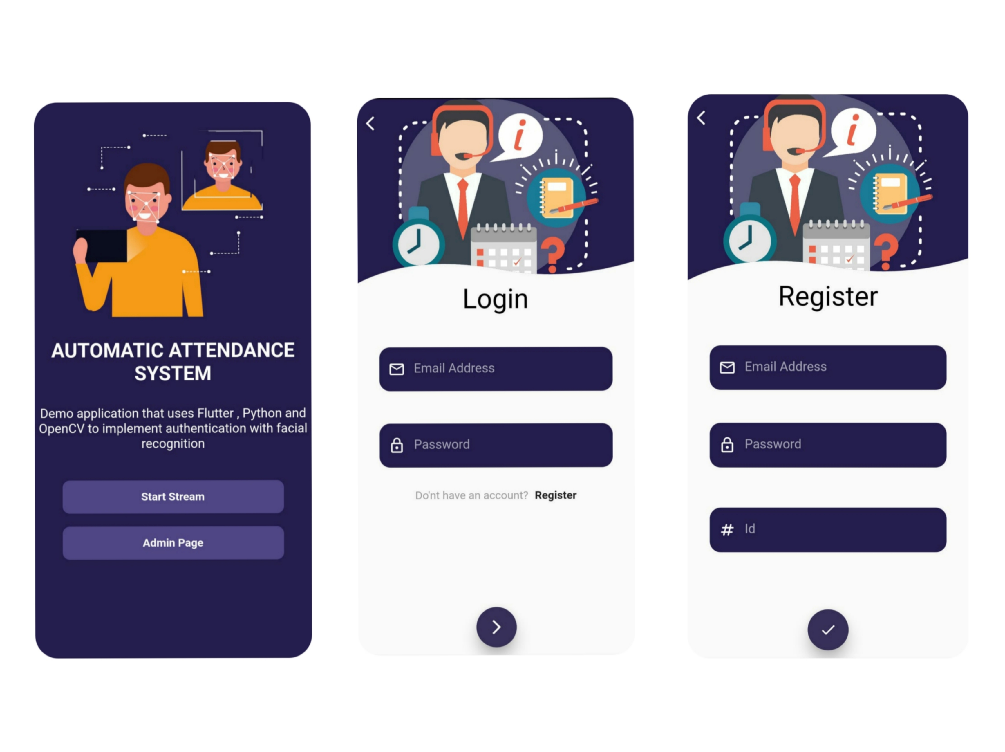

Slide 17
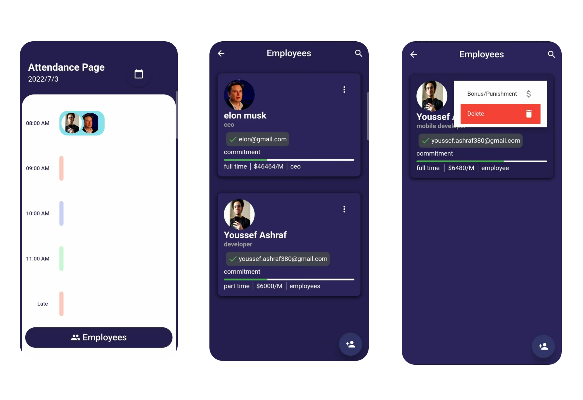

Slide 18
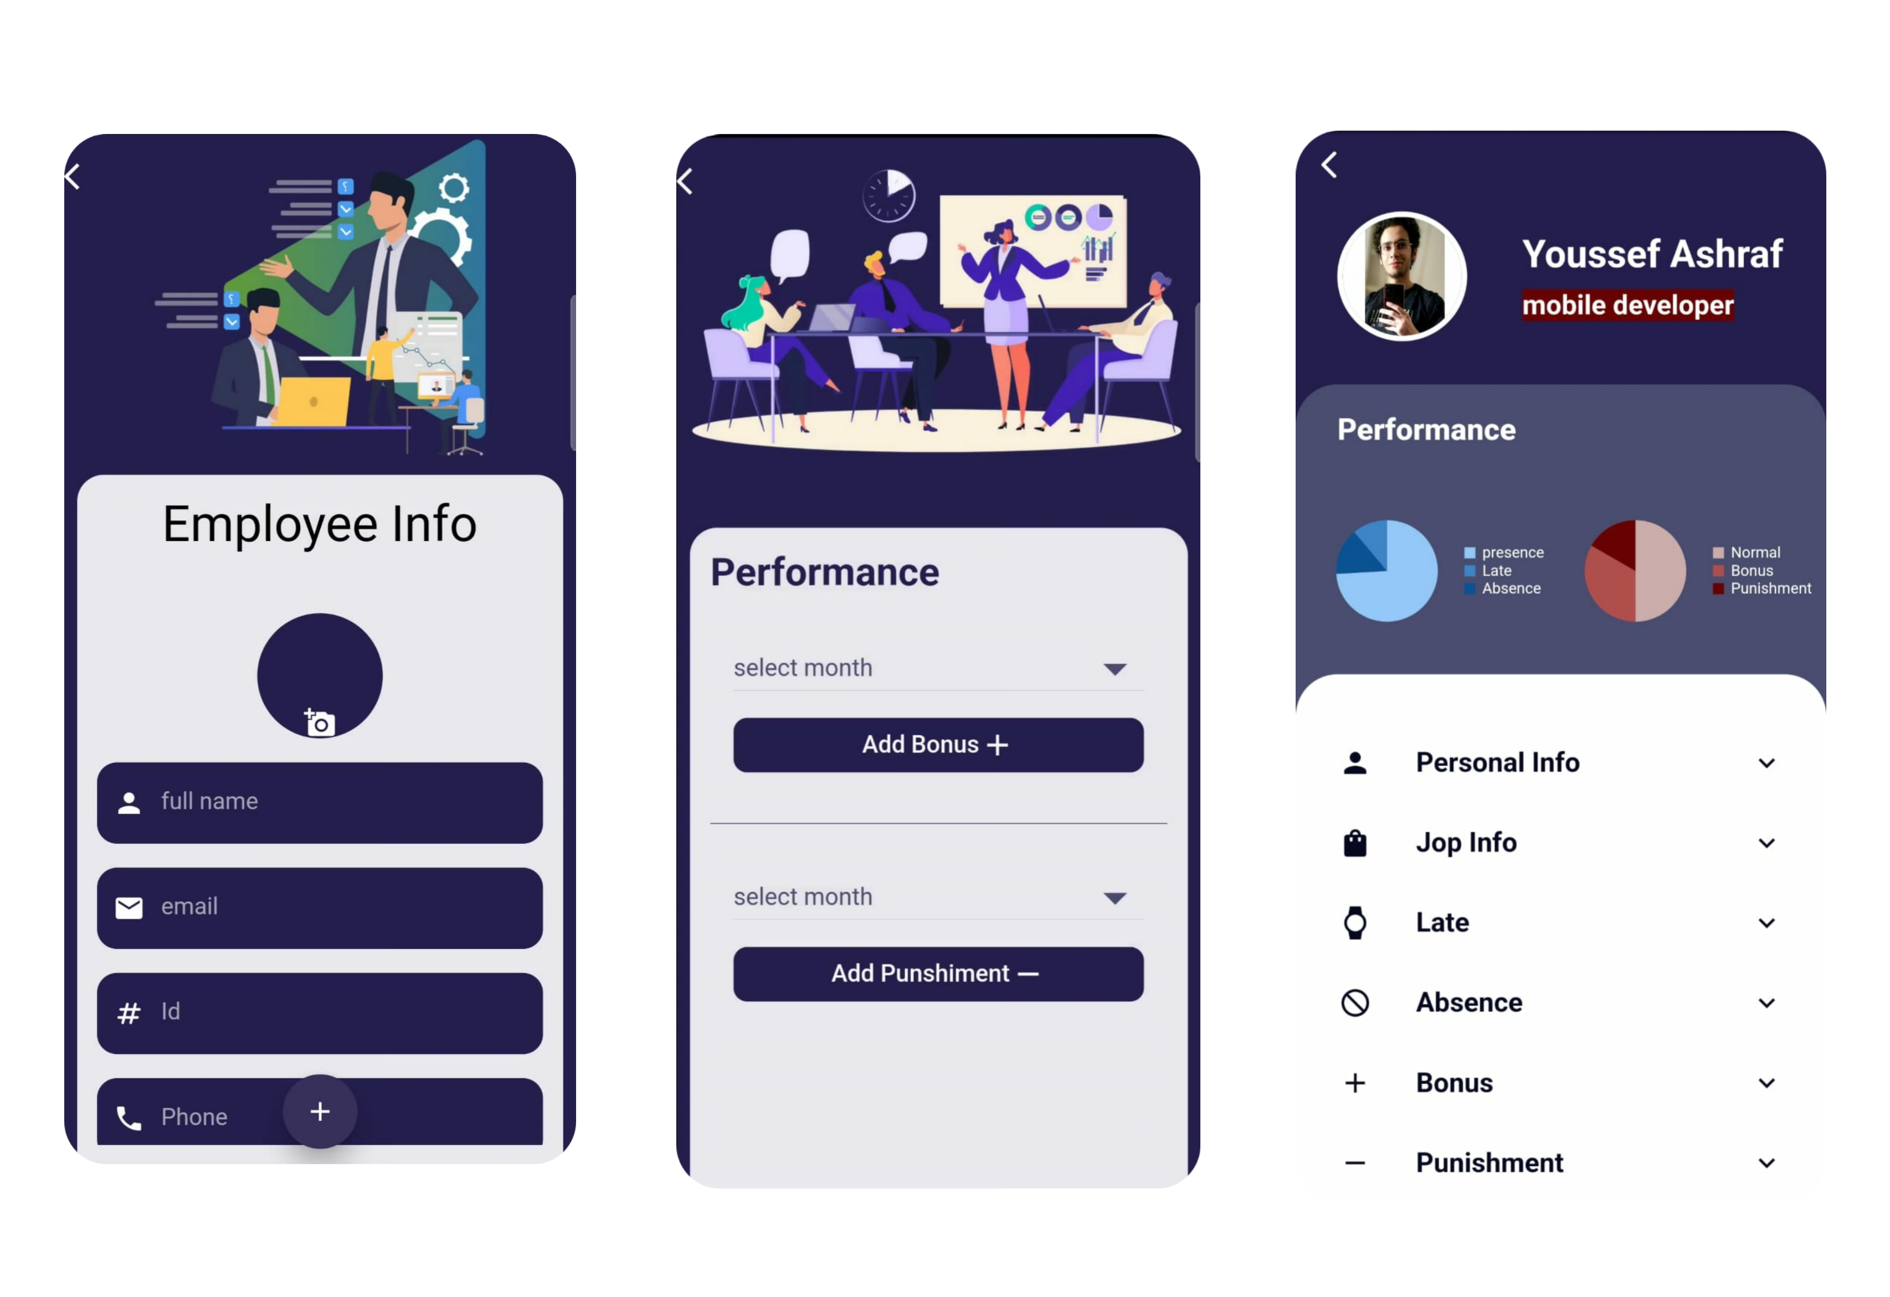

Slide 19
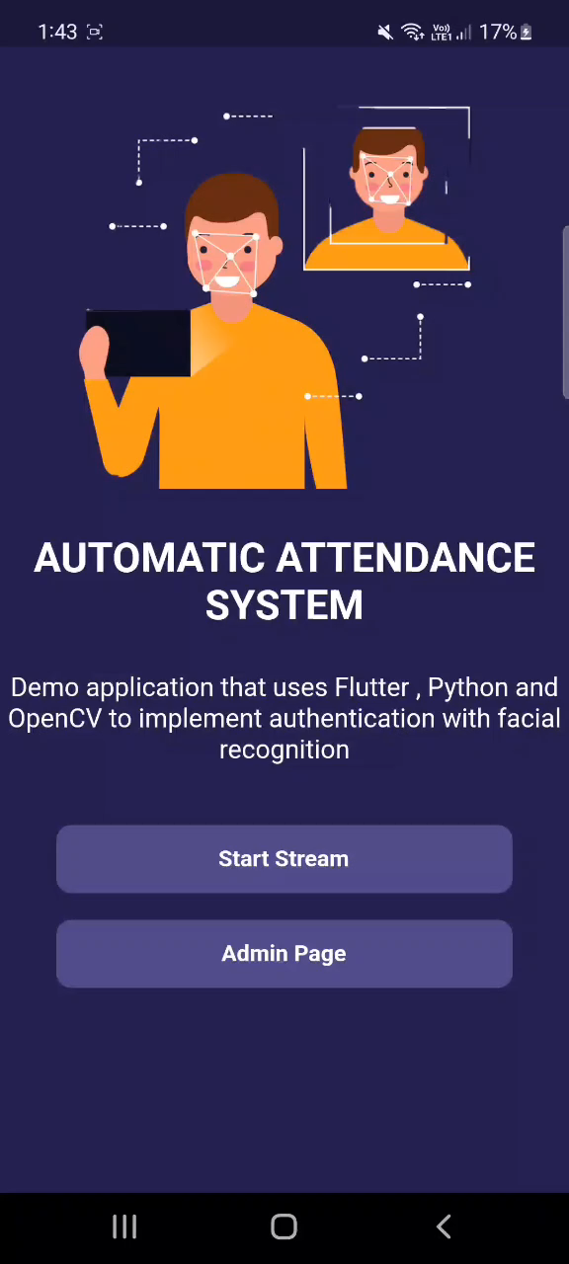

Slide 20
Conclusion
The result of our preliminary experiment shows improved
performance in the estimation of the attendance compared
to the traditional attendance marking systems.
Notes:
OpenCV uses machine learning algorithms to search for faces within a picture. Because faces are so complicated, there isn’t one simple test that will tell you if it found a face or not. Instead, there are thousands of small patterns and features that must be matched. The algorithms break the task of identifying the face into thousands of smaller, bite-sized tasks, each of which is easy to solve. These tasks are also called classifiers.

Slide 21
Thus concluded from above discussion is that our proposed
system is cost effective, secure, reliable, fast, better
and efficient module is developed to replace unreliable
and manual system.
Notes:
OpenCV uses machine learning algorithms to search for faces within a picture. Because faces are so complicated, there isn’t one simple test that will tell you if it found a face or not. Instead, there are thousands of small patterns and features that must be matched. The algorithms break the task of identifying the face into thousands of smaller, bite-sized tasks, each of which is easy to solve. These tasks are also called classifiers.

Slide 22

Future work
In the future we intend to make administrator able to manage
the system at the same time the system recording attendance.
we also can make other versions for different
operating systems like IOS, Windows, macOS and the Web platform,
that’s why we decided to use Flutter, It is the most popular
cross platform mobile SDK
Notes:
OpenCV uses machine learning algorithms to search for faces within a picture. Because faces are so complicated, there isn’t one simple test that will tell you if it found a face or not. Instead, there are thousands of small patterns and features that must be matched. The algorithms break the task of identifying the face into thousands of smaller, bite-sized tasks, each of which is easy to solve. These tasks are also called classifiers.

Slide 23
References

Slide 24
[1] M. A. Turk and A. P. Pentland, “Face Recognition Using Eigenfaces,” in Proc.
IEEE Conference on Computer Vision and Pattern Recognition, pp. 586–591. 1991.
[2] A. J. Goldstein, L. D. Harmon, and A. B. Lesk, “Identification of Human Faces,” in Proc.
IEEE Conference on Computer Vision and Pattern Recognition, vol. 59, pp 748 – 760, May 1971
[3] M. A. Fischler and R. A. Elschlager, “The Representation and Matching of Pictorial
Structures,” IEEE Transaction on Computer, vol. C-22, pp. 67-92, 1973.
[4] S. S. R. Abibi, “Simulating evolution: connectionist metaphors for studying human
cognitive behaviour,” in Proceedings TENCON 2000, vol. 1 pp 167-173, 2000.
[5] Y. Cui, J. S. Jin, S. Luo, M. Park, and S. S. L. Au, “Automated Pattern Recognition
and Defect Inspection System,” in proc. 5 th International Conference on Computer Vision
and Graphical Image, vol. 59, pp. 768 – 773, May 1992

Slide 25
[6] Y. Zhang and C. Liu, “Face recognition using kemel principal component analysis and
genetic algorithms,” IEEE Workshop on Neural Networks for Signal Processing,
pp. 4-6 Sept. 2002.
[7] J. Zhu and Y. L. Yu, “Face Recognition with Eigenfaces,” IEEE International Conference
on Industrial Technology, pp. 434 -438, Dec. 1994.
[8] M. H. Yang, N. Ahuja, and D. Kriegmao, “Face recognition using kernel
eigenfaces,” IEEE International Conference on Image Processing, vol. 1, pp. 10-13, Sept. 2000.
[9] T. D. Russ, M. W. Koch, and C. Q. Little, “3D Facial Recognition: A
Quantitative Analysis,” 38th Annual 2004 International Carnahan Conference on
Security Technology, 2004.
[10] P. Sinha, B. Balas, Y. Ostrovsky, and R. Russell, “Face Recognition by Humans: Nineteen
Results All Computer Vision Researchers Should Know About,” in Proceedings
of the IEEE, vol. 94, Issue 11, 2006.

Slide 26
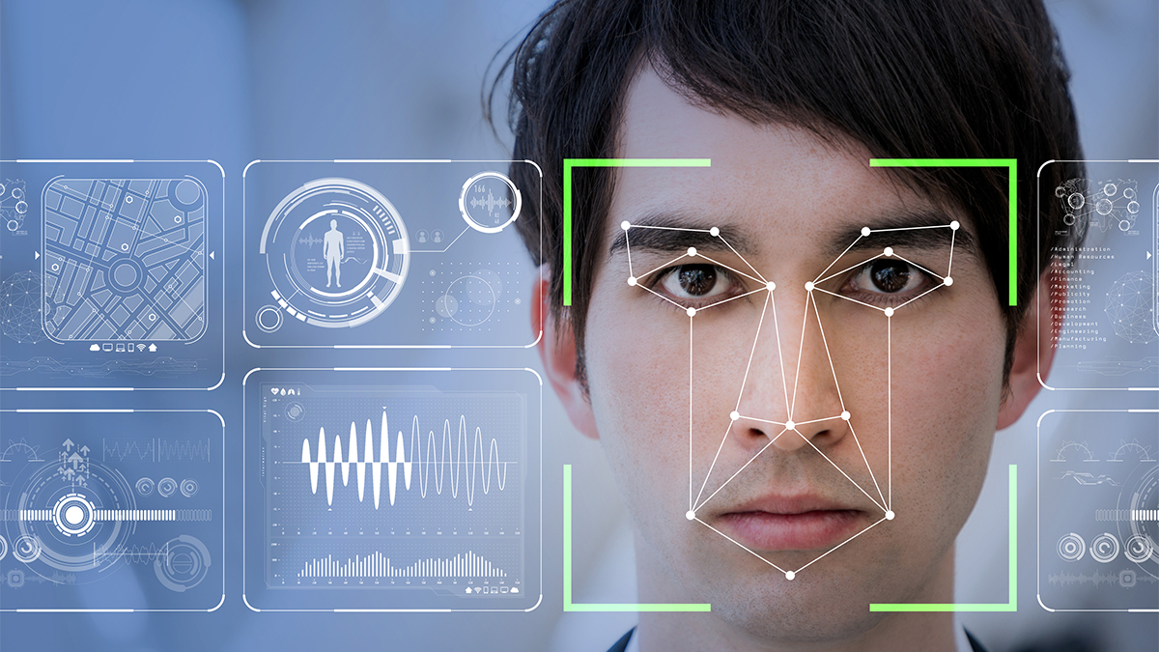
Any Questions ?

Slide 27
Thank You

